Slide 1

Functional & clinical application of the 2017 periodontal classification in a general practice setting
Andrew Stevenson D.D.S.
Wednesday, January 24, 2023
This 1-hour course is provided by an approved CE sponsor on a topic relevant to clinical dentistry per IAC 650-25.5.

Slide 2
Objectives
Introduce the 2018 case descriptions and criteria from the 2017 World Workshop on the Classification of Periodontal and Peri-implant Diseases and Conditions.
Contrast this framework with the previous 1999 diagnostic framework.
Focus on clinical application and utility for staff in a general practice setting.
Discuss how better identifying disease and disease progression can, and should, impact treatment.
Discuss the clinical significant of the ‘once perio, always perio’ consensus.
Discuss the clinical significance of routine clinical findings.

Slide 3
In November of 2017, the American Academy of Periodontology and the European Federation of Periodontology held a joint workshop. They split into four groups that each tackled a single issue and reported their findings as a series of papers in 2018.

Slide 4
Workgroup 1
Health & gingivitis
Workgroup 2
Periodontitis
Workgroup 3
Periodontal manifestations of systemic diseases and developmental and acquired conditions
Workgroup 4
Peri-implant diseases and conditions

Slide 5
The final result was an academic feat, with ongoing debate and without consensus; not even the individual workgroups agreed with one another.
…This is still true in 2023…

Slide 6
So let’s set the complexities, sticking points, and intricacies aside and talk about ways to use this framework to better describe and treat our patients.

Slide 7
Key concepts
& thought starters

Slide 8
Probing depths (PDs)
No standardization of probes.
No way to ensure uniform pressure (0.25N is ideal)
”PPD or probing attachment levels alone should not be used as evidence of gingival disease or health.”³

Slide 9
Bleeding on probing
Best indicator of presence of inflammation (at .25 N of pressure).³
Primary parameter for gingivitis.⁴
Absence of BOP has been shown to be 98-99% predictive of no disease.^{6,7}

Slide 10
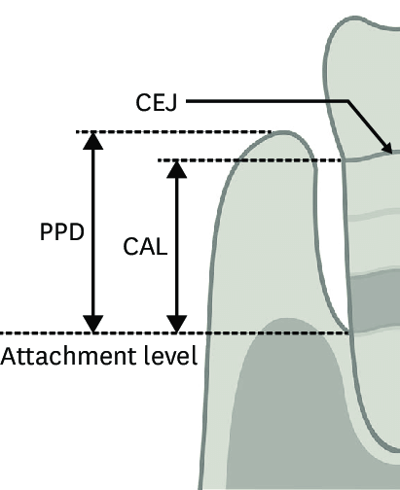
Clinical attachment level (CAL)
Measures the attachment level in relation to a fixed constant, the CEJ.
It is a calculation, not a measurement.
PD + distance from the gingival margin to the CEJ.

Slide 11
Tooth mobility
Can be related to occlusal trauma or periodontal disease.³
Not a sign of health or disease status.³

Slide 12
‘Once perio, always perio’

Slide 13
Periodontal health

Slide 14
What did it use to be?
Healthy gingiva

Slide 15
Periodontal health on an intact periodontium
Pristine periodontal health
  Total absence if clinical signs of inflammation on an intact periodontium.
  Unlikely to be observed clinically…
Well-maintained clinical periodontal health
  Minimal levels of inflammation on an intact periodontium

Slide 16
Periodontal health on a reduced priodontium
Periodontal disease stability.
  Successful treatment of periodontal disease .
    Minimal BOP, decreased PDs to ideal, no further destruction.
  Modifying factors such as smoking and diabetes are improved.
Periodontal disease remission/control.
  Improvement of periodontitis after treatment.
    BoP and PDs are reduced, but not to ideal.
    Modifying factors such as smoking and diabetes remain unchanged.

Slide 17
 | Pristine periodontal health | Clinical periodontal health | Periodontal disease stability | Periodontal disease control
Status of periodontium | Intact |  | Reduced
BoP | None | Minimal | Minimal | Decreased after treatment
Probing depths | Normal | Normal | Increased | Increased
Modifying factors | Controlled | Controlled | Controlled | Not controlled

Slide 18
Questions?

Slide 19
Gingivitis

Slide 20
What did it use to be?
Localized | Slight | Acute | Gingivitis
 | Moderate
Generalized |  | Chronic
 | Severe

Slide 21
Gingivitis: universal features¹
Clinical signs and symptoms of inflammation confined to the free and attached gingiva and do not extend beyond the mucogingival junction.
Reversibility of the inflammation by removing the biofilm
Presence of plaque burden
Intact periodontium

Slide 22
Gingivitis: clinical findings¹
Erythema
Edema
Bleeding
Tenderness
Enlargement

Slide 23
Gingivitis: radiographic findings
Generally, no changes radiographically to the periodontium.
  Exception is a diagnosis on a reduced periodontium.

Slide 24
Potential modifying factors of plaque induced gingivitis¹
Systemic
  Endocrine changes
    Oral contraceptives
    Puberty
    Pregnancy
  Hyperglycemia
  Leukemia
  Smoking
  Malnutrition
Oral
  Xerostomia
  Subgingival restoration margins
Medication

Slide 25
”It is plausible that, since gingival inflammation is a ubiquitous and endemic finding in children and adults worldwide and destruction of the the periodontal attachment apparatus is associated with only a select number of inflamed gingival sites and since this is generally not a painful or functionally destructive state resulting in loss of function, gingival inflammation may not be a disease but a variant of health.” ¹

Slide 26
What is it now?
Localized (<30% of teeth) | Slight (minor color change, no surface change) | Gingivitis
 | Moderate (bleeding on probing, redness, edema)
Generalized (>30% of teeth)
 | Severe (bleeding on touching, overt redness and edema)
Incipient (few sites with mild redness, inflammation, and delayed bleeding)
Localized
Slight
Gingivitis
Moderate
Generalized
Severe

Slide 27
Incipient gingivitis
“Only a few sites are affected by mild inflammation, expressed as mild redness and/or a delayed and broken line of bleeding, rather than edema or an immediate, unbroken line of bleeding on probing”¹.
Seemingly synomous with clinical periodontal health³.

Slide 28
Questions?

Slide 29
”…gingival inflammation may be a sufficient cause for destruction of the periodontium but insufficient on its own to cause the disease in all people.” ¹

Slide 30
Periodontitis

Slide 31
3 forms²
Necrotizing periodontitis
Periodontitis as a manifestation of systemic disease
Periodontitis

Slide 32
What did it use to be?
Extent, severity, & pattern of disease
  Generalized, moderate, chronic periodontitis
  Localized, severe, aggressive periodontitis

Slide 33
Periodontitis: case definition²
Clinical attachment loss of ≥2 non-adjacent teeth
-OR-
Clinical attachment loss of ≤ 3mm with pocketing >3mm present at ≥2 teeth.

Slide 34
Periodontitis: clinical findings²
Loss of periodontal tissue support (bone) due to inflammation.
Clinically described as:
  High number of sites with BOP.
  High number of sites with CAL of ≥3mm
    Generally means a high number of sites with PDs ≥ 4mm.

Slide 35
Periodontitis: radiographic findings
Alveolar bone loss (secondary feature).

Slide 36

What now?
Location | Stage | Grade
Assessment of number and location of sites | Denotes the severity and management complexity | Assessment of rate of progression
Where is it? | Where are we? | Where are we going?

Slide 37
Staging periodontal disease²
Stage 1
  Border between gingivitis and periodontitis. Early stages of attachment loss.
Stage 2
  Established periodontitis.
Stage 3
  Significant damage has occurred. At risk of loosing teeth. Periodontal lesions extend to halfway down the tooth.
Stage 4
  Considerable damage has occurred. At risk of loosing many or all teeth.

Slide 38
Staging
Slight
Mod.
Severe

Slide 39
Location and extent
Localized
  ≤30% of sites in the mouth.
Generalized
  ≥30% of sites in the mouth
Molar-incisor pattern
  Characterized by vertical defects on the first molars and anterior teeth, particularly in the mandible. (Previously in the realm of aggressive or juvenile periodontitis.)

Slide 40
Grading periodontal disease²
Grade A
  Slow rate of progression
Grade B
  Moderate rate of progression
Grade C
  Rapid rate of progression

Slide 41
Grade modifiers²
Smoking
  Smoking < 10 cigarettes per day automatically qualifies for Grade B
  Smoking ≥ 10 cigarettes per day automatically qualifies for Grade C
Diabetes
  Diagnosis of diabetes with HbA1c < 7.0% automatically qualifies for Grade B
  Diagnosis of diabetes with HbA1c ≥ 7.0% automatically qualified for Grade C.

Slide 42
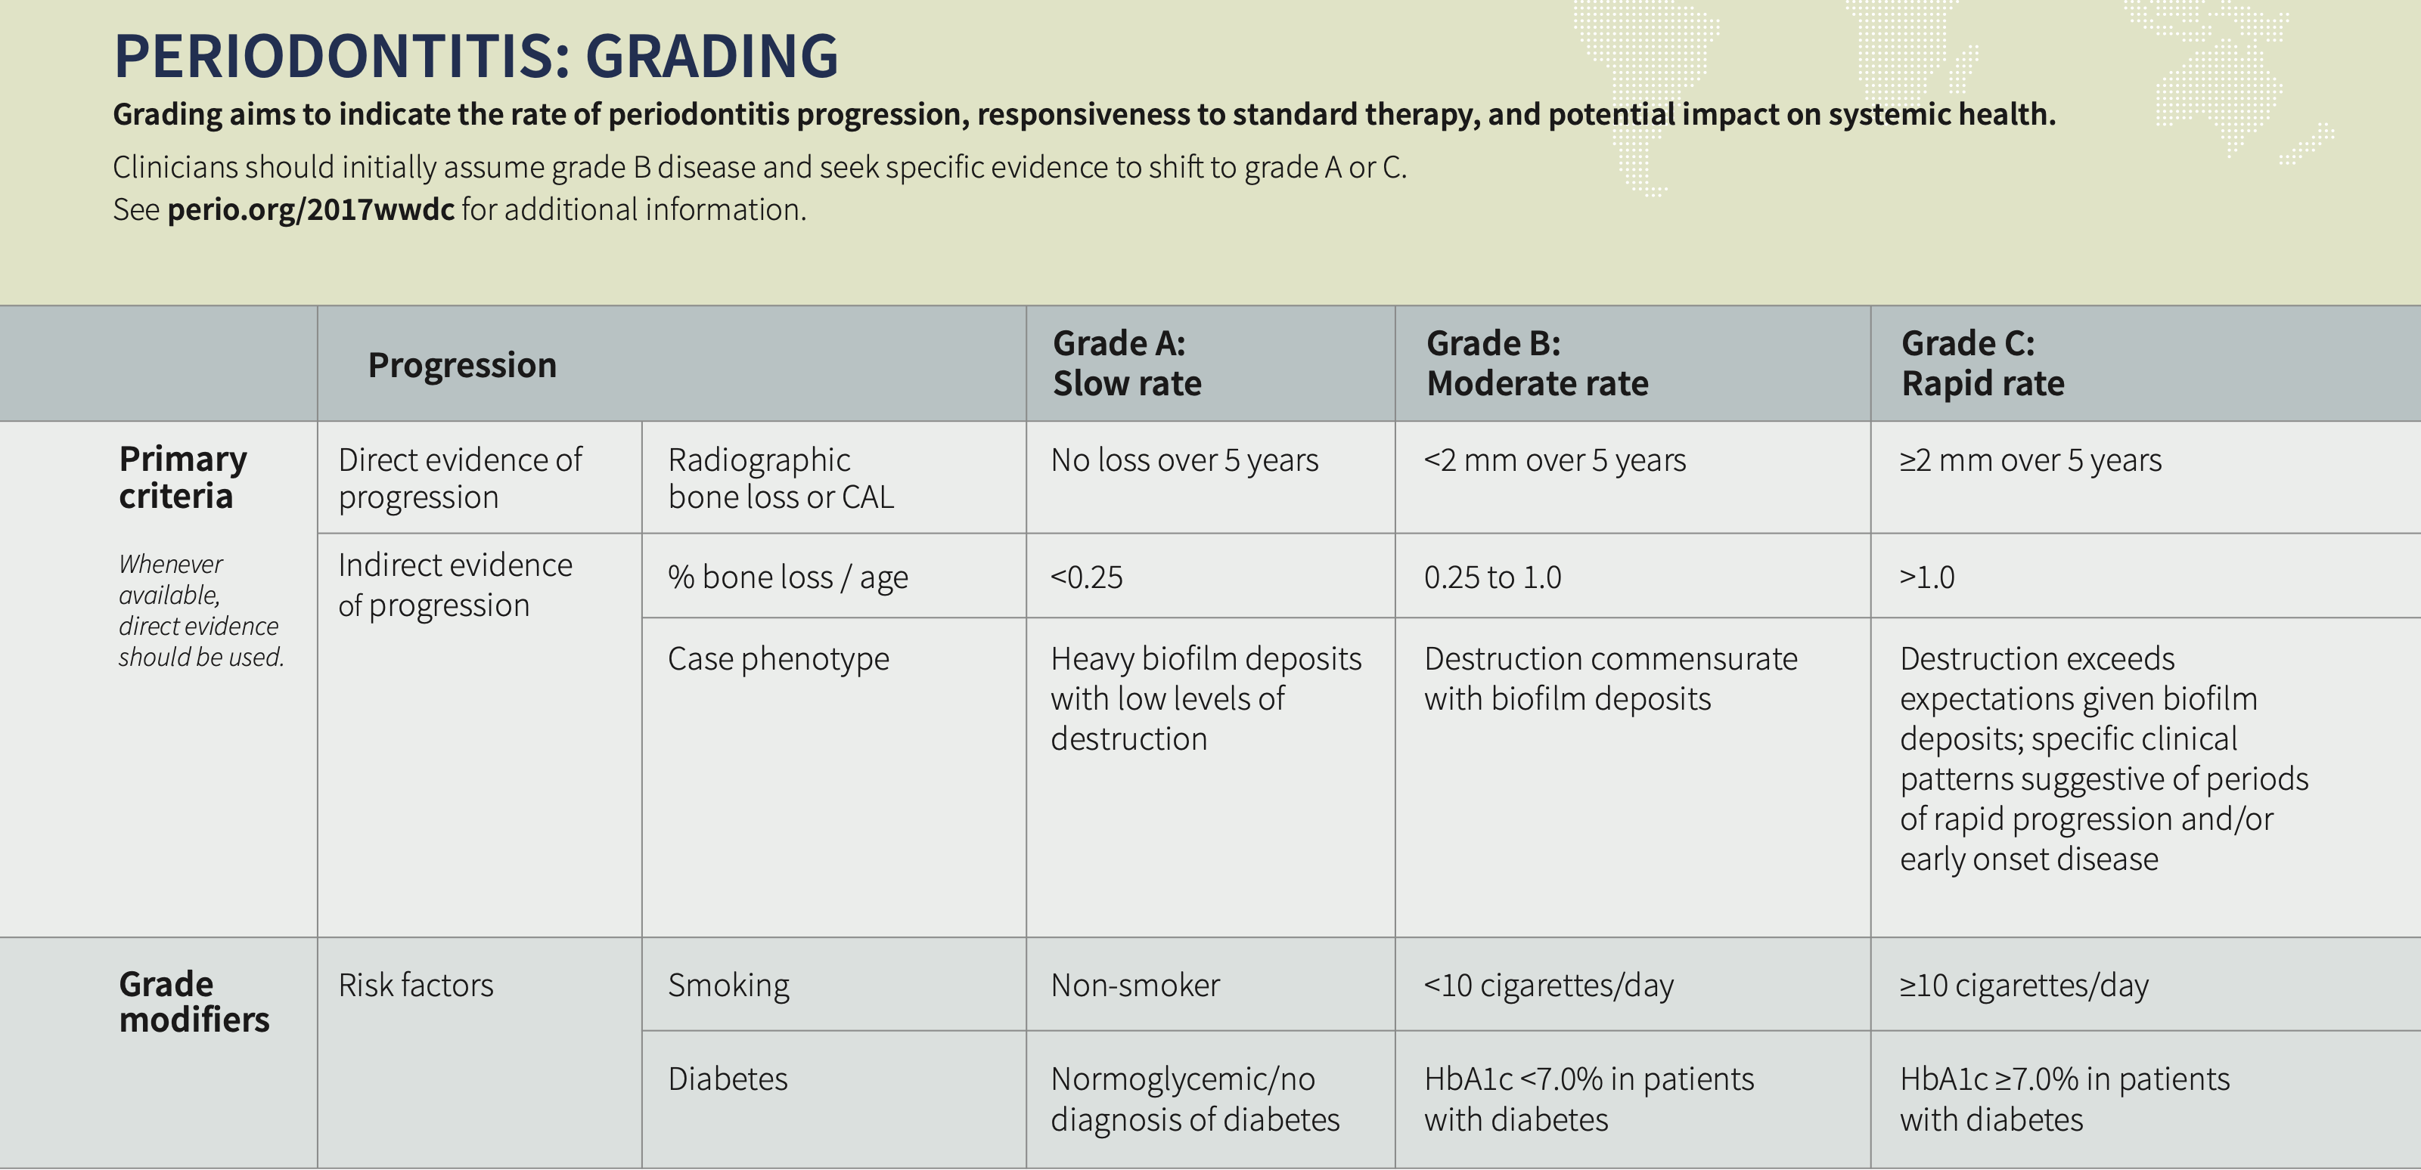

Slide 43
Stage 1 | Localized | Grade 1 | Periodontitis
Stage 2
 | Generalized | Grade 2
Stage 3
 | Molar-incisor pattern | Grade 3
Stage 4

Slide 44
Questions?

Slide 45
Dental implants

Slide 46
Peri-implant diseases⁴
Peri-implant health
Peri-implant mucositis
Peri-implantitis

Slide 47
Peri-implant health⁴
Clinical findings: no visual signs of inflammation or BOP
Probing: not a good indicator.
Radiographic findings: not a good indicator unless serial. If serial, no bone loss.

Slide 48
Peri-implant mucositis⁴
Synonymous with gingivitis around an implant.
Clinical findings: bleeding on probing.
Probing: not a good indicator.
Radiographic findings: Radiographic findings: not a good indicator unless serial. If serial, no bone loss.

Slide 49
Peri-implantitis⁴
Synonymous with periodontitis around an implant
Clinical findings: Bleeding on probing. Poor plaque control.
Probing: not a good indicator.
Radiographic findings: Radiographic findings: not a good indicator unless serial. If serial, bone loss would be present.

Slide 50
Questions?

Slide 51
Recession

Slide 52
Recession facts
Prevalent, and increases with age⁵.
  ≥88% of individuals over the age of 65 report recession⁵.
Unknown etiology, but there are predisposing factors:⁵
  Periodontal biotype
  Toothbrushing
  Restorative margins
  History of orthodontics

Slide 53
Recession types⁵
Type 1 (RT1)
  Recession with no change at interproximal locations
Type 2 (RT2)
  Recession with some interproximal loss but less than or equal to the straight buccal/facial/lingual/palatal surface
Type 3 (RT3)
  Recession with interproximal greater than the straight buccal/facial/lingual/palatal surface

Slide 54
Questions?

Slide 55
References
1: Shinua, M., et al. Dental plaque-induced gingival conditions. Journal of Clinical Periodontology. 2018. 45.
2: Tonetti, M., et al. Staging and grading of periodontitis: Framework and proposal of a new classification and case definition. Journal of Periodontology. 2018. 89.
3: Lang, N., and Bartold, P., Periodontal health. Journal of Clinical Periodontology. 2017. 45.
4: Caton, J., et al. A new classification scheme for periodontal and peri-implant diseases and conditions – Introduction and key changes from the 1999 classification. Journal of Clinical Periodontology. 2018. 45.
5: Cortellini, P., and Bissada, N. Mucogingival conditions in the natural dentition: Narrative review, case definitions, and diagnostic considerations. Journal of Clinical Periodontology. 2018. 45.
6: Lang, N., et al. Absence of bleeding on probing. An indicator or periodontal stability. Journal of Clinical Periodontology. 1994. 17.
7: Joss, A., et al. Bleeding on probing. A parameter for monitoring periodontal conditions in clinical practice. Journal of Clinical Periodontology. 1994. 21.

